Slide 1
Tech Talk: ADCs and Timers
02/31/2020| Adithya Subbiah

Slide 2
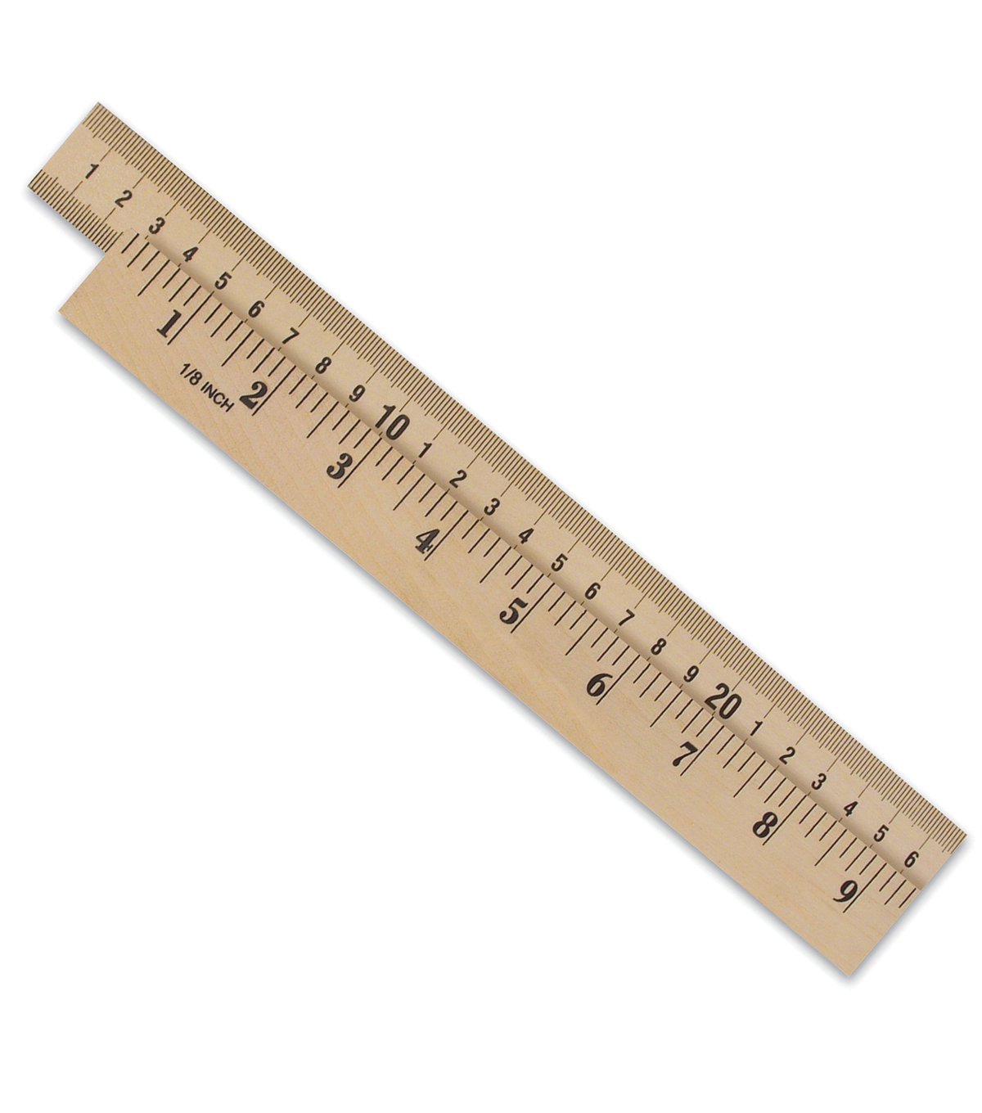
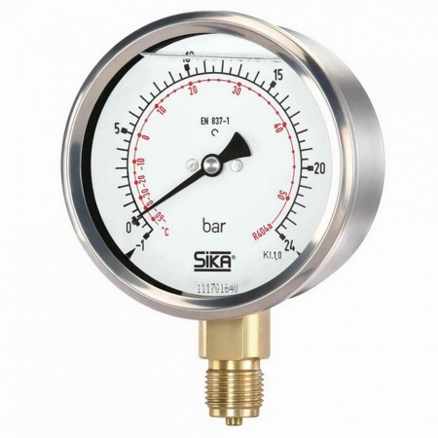

What is the real world measured in?

Slide 3
Transducers
We use transducers (generic term for sensors) to measure real world
Transducer
Temperature/Pressure/etc.
Voltage

Slide 4
Digitization of Voltage
New Problem!
Need some way of converting Voltage into Binary (the language computers understand)
Solution:
This is where we use an Analog to Digital Converter (ADC)!

Slide 5
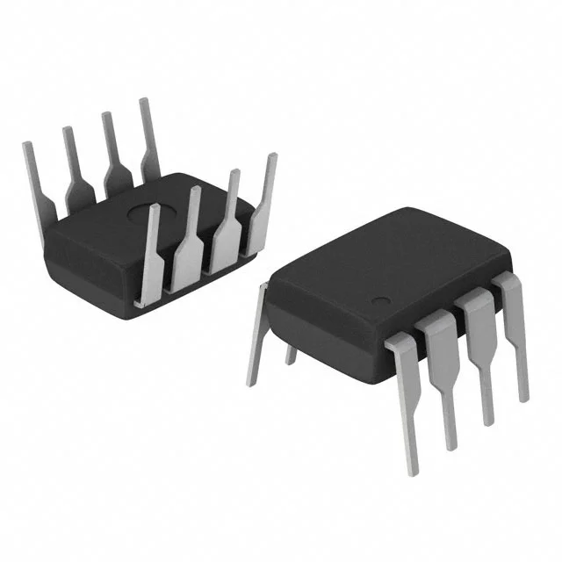
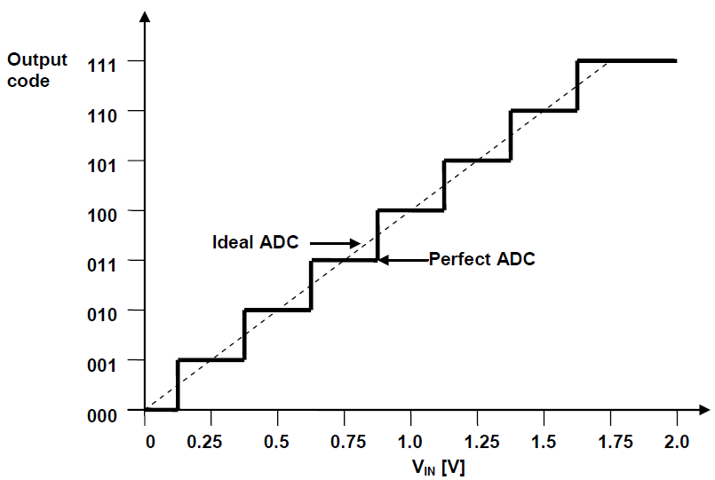
ADC
ADCs output a unique binary value for every voltage level input
Think of it like a function!

Slide 6
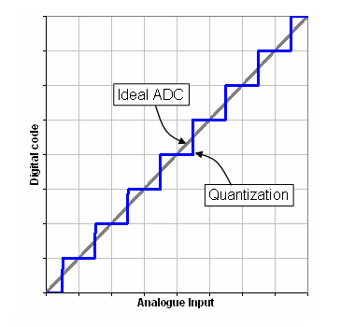
Quantization
With ADCs, we lose some accuracy due to discretization
This “inaccuracy” is called Quantization (Q).
Modeled by: Q = Voltage Range / 2^n,
where n is the # of bits of the ADC

Slide 7
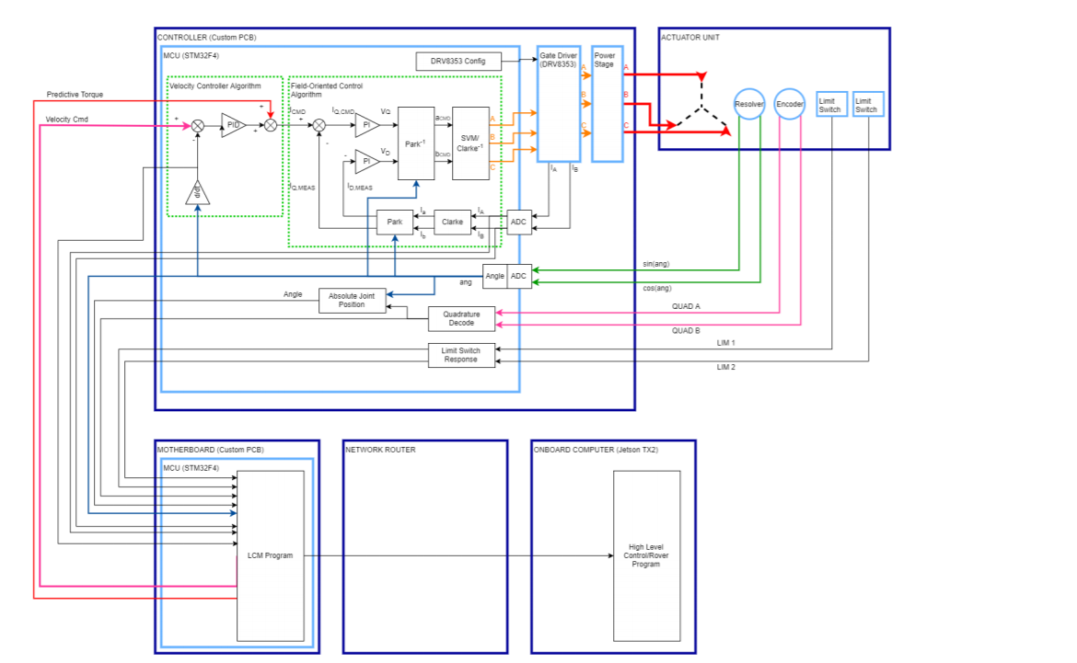
In context
Sensored FOC:
Reading Resolver
Sensorless FOC:
Reading currents
This part of the code needs
to be written!

Slide 8
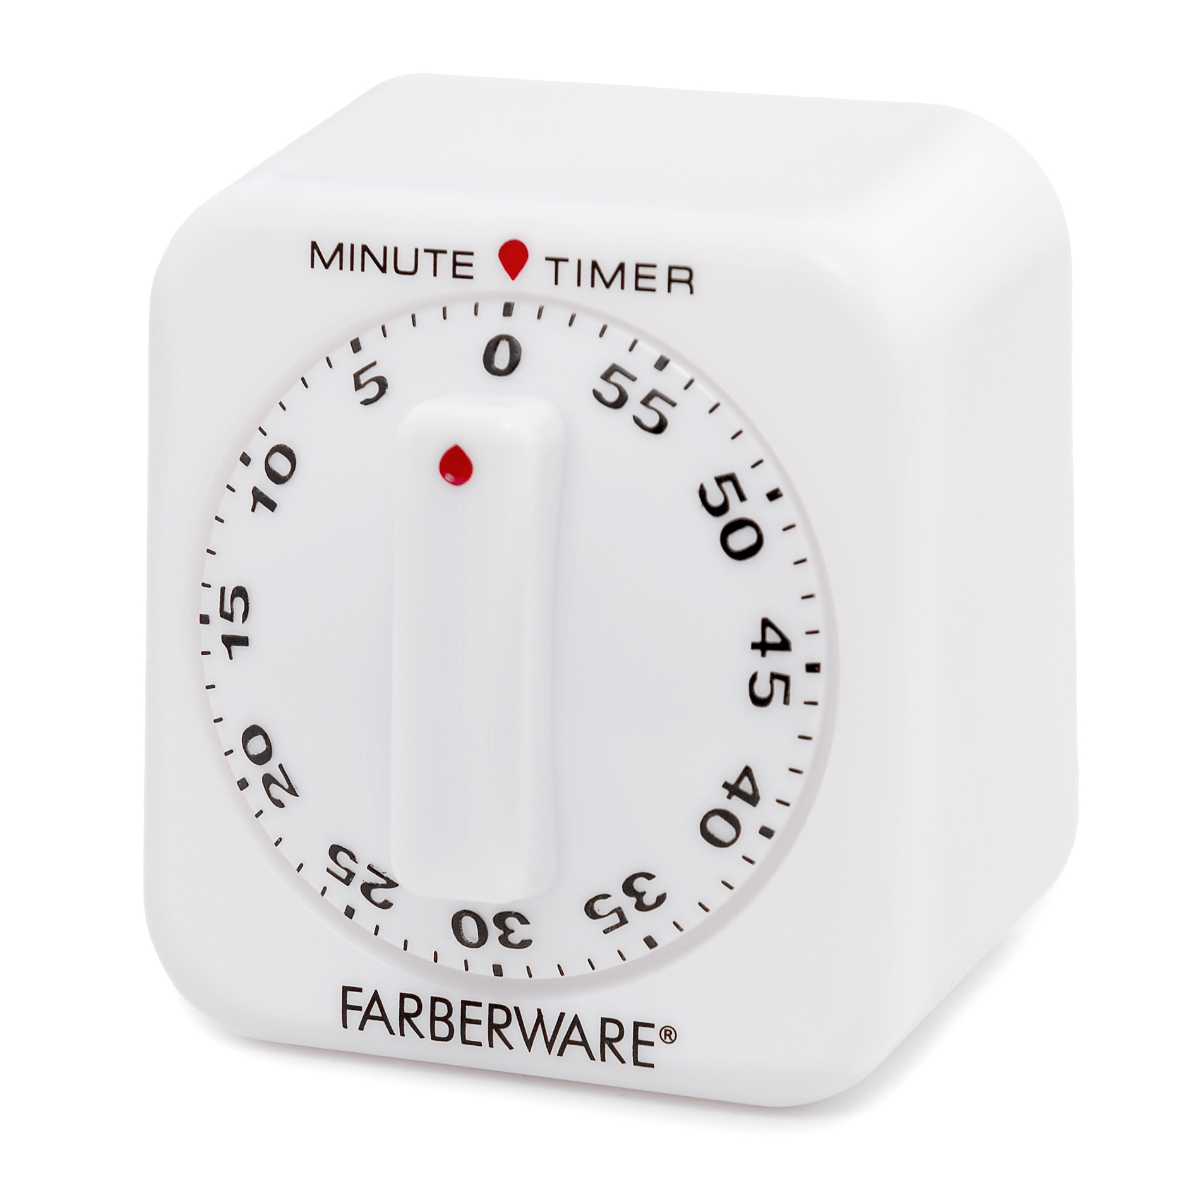
Timers
Analogous to Counters!
On every clock tick, the timer increments by 1
We can use this to keep track of time in higher orders
PWM generation
Note to keep in mind!
Timers can overflow! If we keep counting past the
register space, we will revert back to 0!

Slide 9
Timer modes
Capture mode
On an event, capture mode “captures” the timer at the moment and saves into register
Compare mode
The timer continually increments until it reaches a programmed value in register and triggers an event

Slide 10
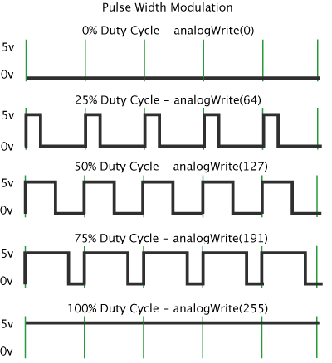
PWM Generation /w Timers
In order to create a “pulse” we can write a program to turn on a gpio pin for some time and then turn off the pin for some time.
This “some time” is governed by a Compare Timer. I.e. continually increment until a certain value then once we hit that value turn off/on pin.
Setting max (overflow) Timer value affects PWM frequency
Setting the Compare value affects duty cycle

Slide 11
Controlling PWM with Timers
We can control the frequency of a PWM signal using the overflow value of the timer!
EX: Programming the timer to overflow at value 255 with a 100kHz clock will give us a 392Hz PWM pulse. (100kHz / 255 = ~392Hz)
Control Duty cycle by changing the Compare value!
EX: Using above parameters, setting Compare to 128 will result in 50% duty cycle, setting Compare to 85 gives us 33% duty cycle. (255 / 2 = 128, 255 / 3 = 85)

Slide 12
In context
FOC:
Send 6 PWM signals (2 per phase) to DRV
(We do commutation ourselves)
This code needs to be written
Trapezoidal:
Send 1 PWM signal to determine duty cycle, DRV handles the rest
(DRV handles commutation using hall sensors)
Code written

Slide 13
Questions?

